Slide 1



Goodcabs Insights Project: Driving Data-Driven Decisions for Growth in Tier-2 Cities
By Anshika | Data Analyst | 2024

Slide 2
Problem Statement
Domain & Function: Transportation & Mobility | Operations
Problem Statement: Goodcabs operates in tier-2 cities and aims to boost trip volume, passenger satisfaction, and repeat passenger rates while achieving ambitious 2024 targets.
Task Assigned: Analyze company performance metrics, answer business questions, and design a Power BI dashboard for actionable insights.
📈
🔁
📊
Growth
Customer Retention
Performance Metrics
Slow growth in trip volume and revenue across target cities.
Declining repeat passenger rates and engagement.
Difficulty meeting key performance metrics like trip volume and ratings.

Slide 3
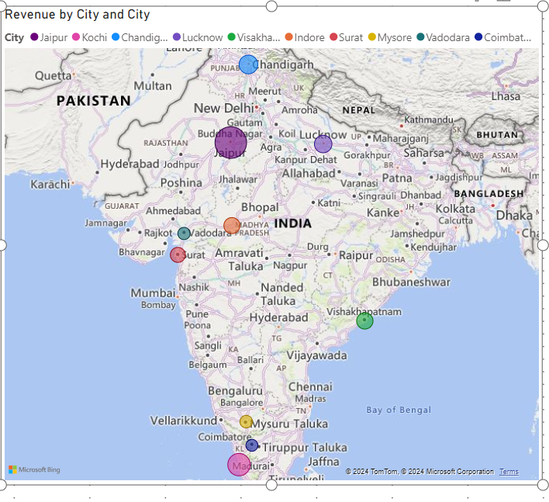

Slide 4


Project Objectives and Goals
Objective: Deliver actionable insights for operational efficiency, customer satisfaction, and revenue growth.
Key Goals:
Analysis: Evaluate trip data, passenger behavior, and .. Driver performance.
Optimization: Identify areas to improve revenue and …..satisfaction.
Recommendations: Actionable steps to achieve business goals.

Slide 5
Data Overview
Data Sources: CSV files from operational databases.
Storage Location: Data stored in a local/SQL database integrated into Power BI.
Update Frequency: Monthly data refresh cycle.
ETL Tool: Power Query used for data cleaning and transformation.
Challenges: Missing values, duplicate entries, and data inconsistencies resolved with Power Query.

Slide 6
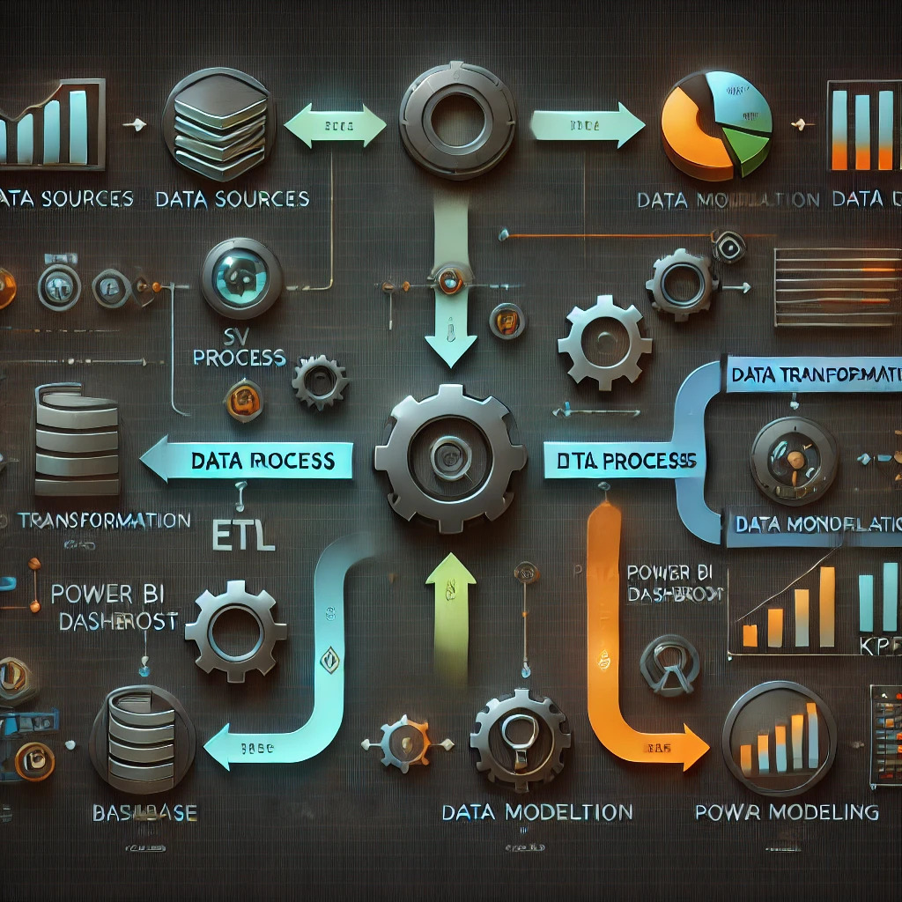

Slide 7
Data Transformation
Transformation Steps:
- Handled missing data (e.g., passenger ratings).
- Resolved cardinality issues in Power BI relationships.
- Created calculated columns (e.g., Revenue per Trip).
Challenges:
- Complex relationships requiring adjustments to Many-to-Many joins.
- Handling large datasets with efficient measures.
Tools Used: Power Query, Python pandas
for preprocessing, SQL for ad-hoc queries.

Slide 8
Data Modeling
Approach:
- Star schema for optimized data modeling.
- Relationships: fact_trips linked to dimension tables like dim_city, dim_date, etc.
Best Practices:
- Avoided circular references.
- Used surrogate keys for cleaner joins.
- Managed Many-to-Many relationships with bridge tables.
Challenges:
- Addressing high cardinality in city and date relationships.

Slide 9
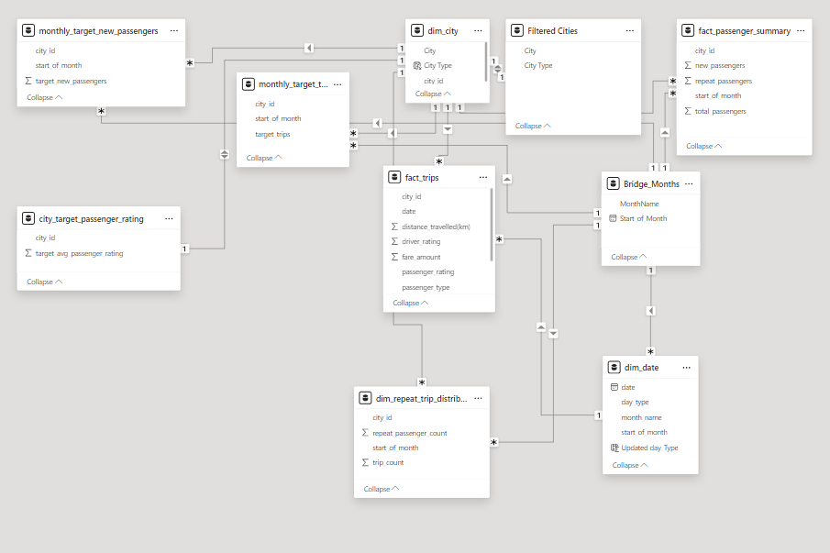

Slide 10
Key Metrics and DAX Functions
Key Metrics:
- Total Trips, Revenue, RPR%, Average Ratings, Revenue per Trip, and Monthly Target Achievement.
DAX Functions Used:
- CALCULATE, SUMX, ALL ,DISTINCTCOUNT, and Time Intelligence functions like SAMEPERIODLASTYEAR.

Slide 11
Dashboard Design
Design Philosophy:
- Dark-themed, futuristic visuals for a professional look.
- Interactive slicers, tooltips, and drill-throughs for better exploration.
Components:
- KPIs: Total Revenue, RPR%, Average Ratings.
- Charts: Revenue by Passenger Type, Ratings by Month, and City Performance.
- Filters: City, Passenger Type, Month.

Slide 12
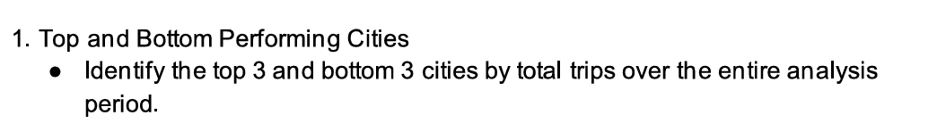

Slide 13
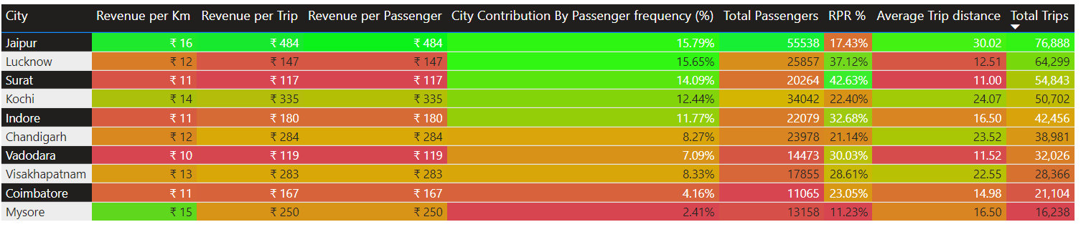
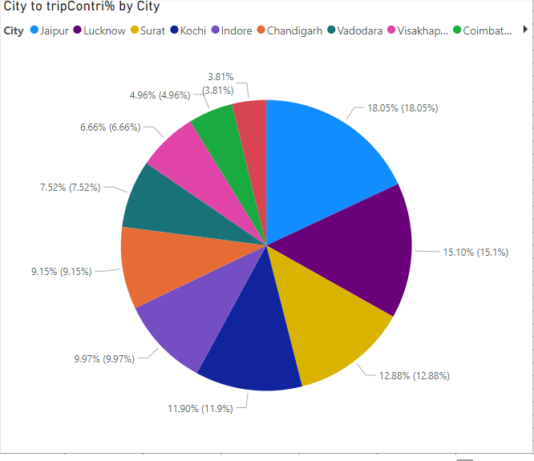

Slide 14
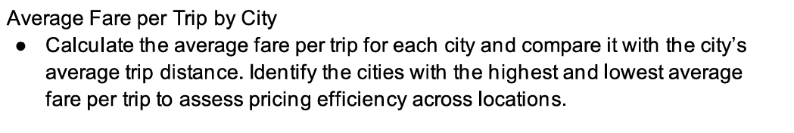

Slide 15
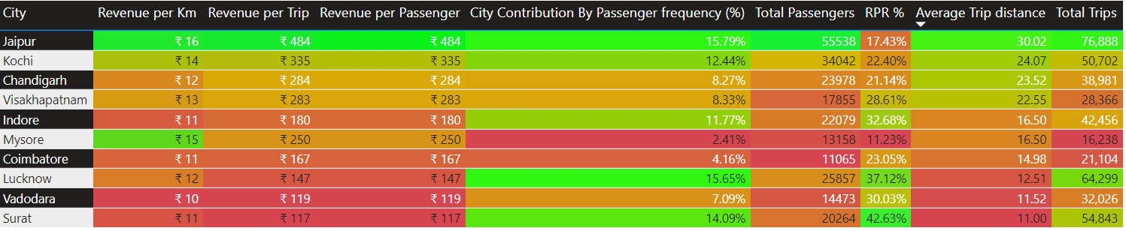
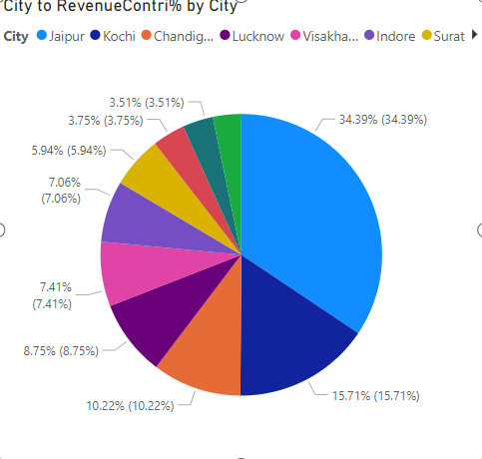

Slide 16
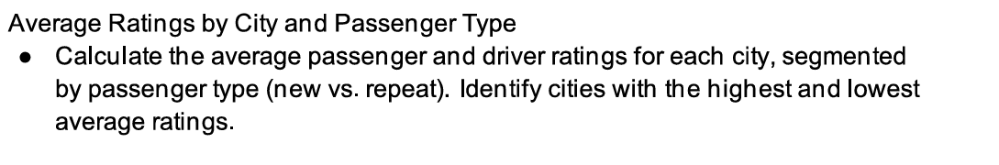

Slide 17
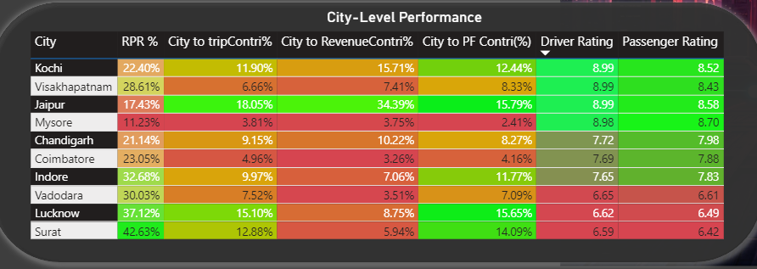
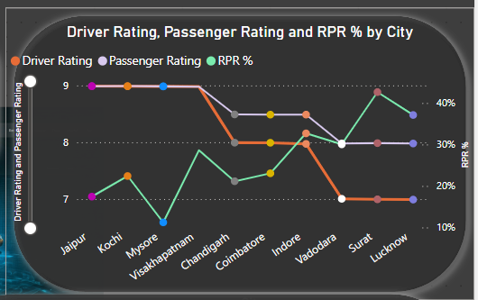
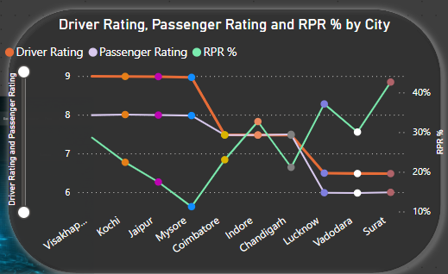
New passenger
Repeated passenger
Notes:
Tourism vs. Business Cities:
Tourism-heavy cities (Jaipur, Kochi, Visakhapatnam): High new passenger ratings and relatively lower RPR%, likely due to transient customers.
Business-centric cities (Lucknow, Surat): Higher RPR% but lower ratings, suggesting repeat customers might tolerate service due to necessity rather than preference.
Rating Trends:
Drop in repeat passenger ratings across all cities signals a gap in maintaining service consistency for loyal customers.
Loyalty Drivers:
High RPR% cities (Surat, Lucknow, Vadodara) likely retain passengers due to factors like affordability or convenience, but their lower ratings indicate a need to invest in driver training, service quality, and customer feedback systems.

Slide 18
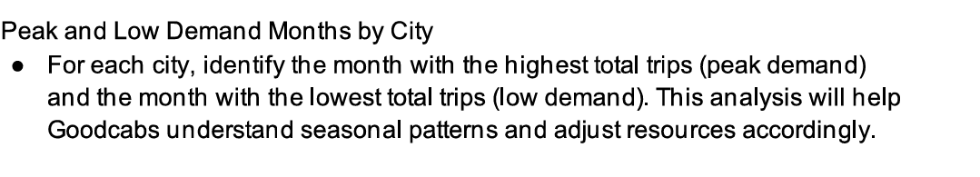

Slide 19
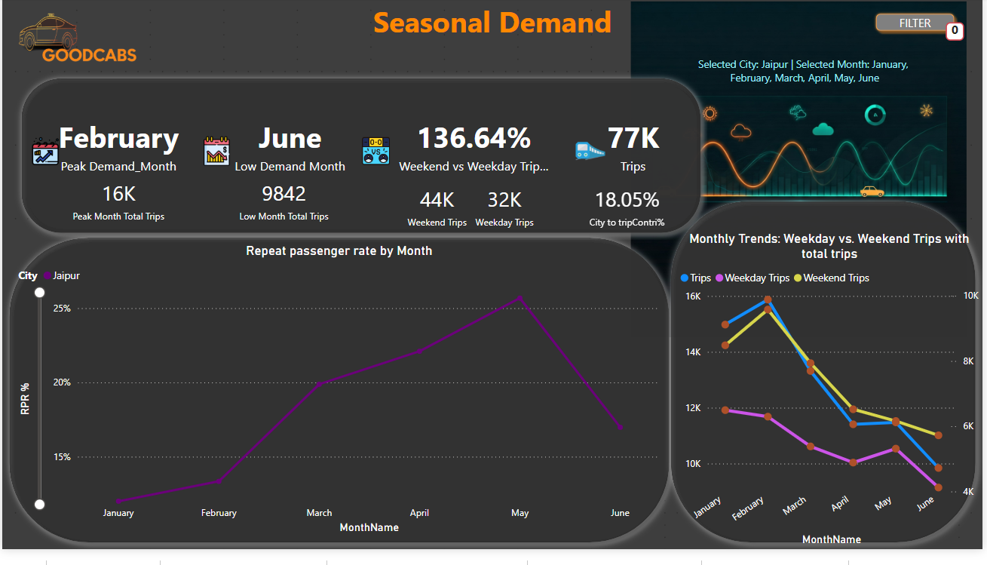

Slide 20
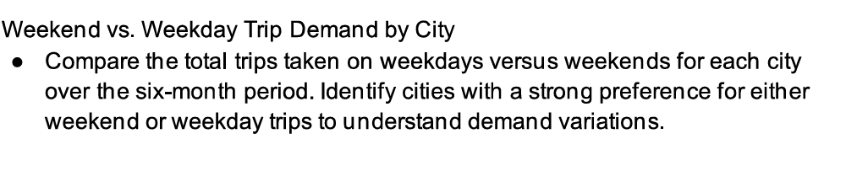

Slide 21
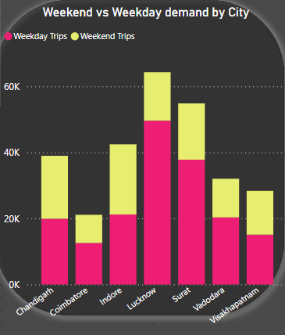
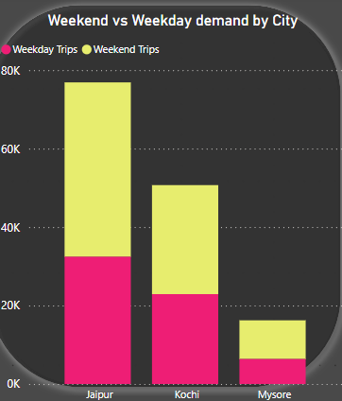
Business focused city
Tourism focused cities

Slide 22
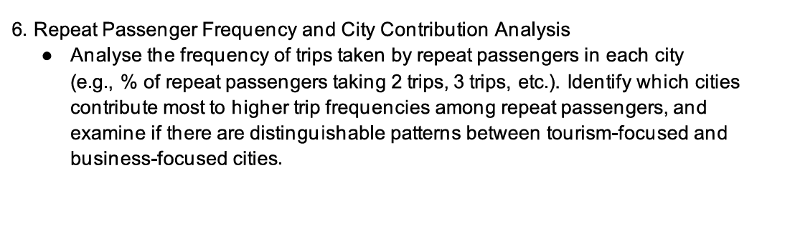

Slide 23
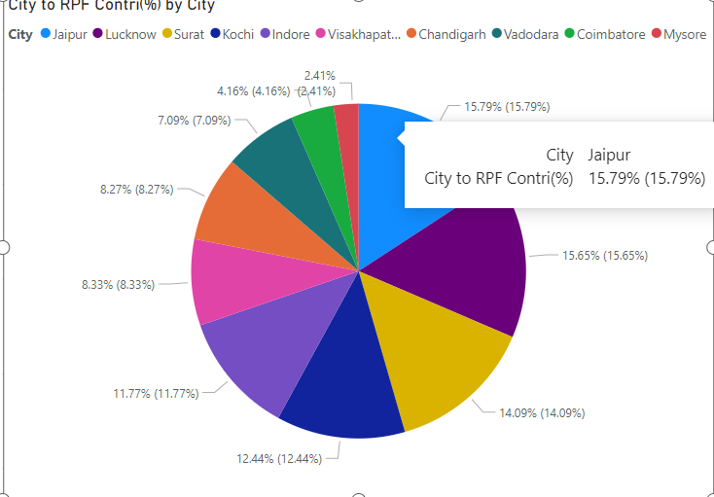
Notes:
MetricScopeKey InsightCity to RPF Contribution (%)Global (across all cities) Cities contributing the most to repeat trips.
Repeat Passenger Frequency (% )Local (within individual cities)Intensity of repeat trips per city.
RPR%City-wide loyalty Ratio of repeat passengers to total passengers.

Slide 24
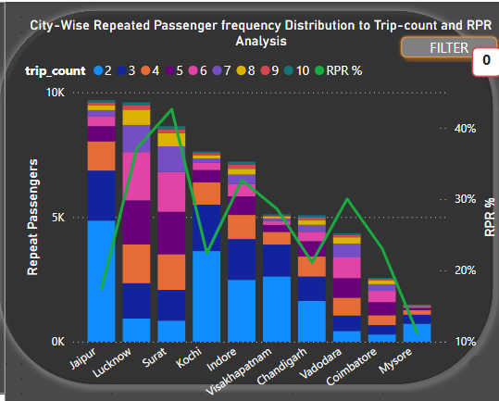
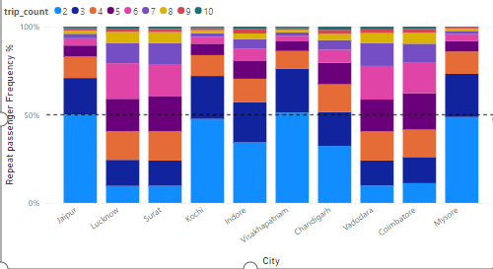
Notes:
Repeat Passenger Frequency and City Contribution Analysis
(a) Repeat Passenger Behavior:
Most Common Trip Frequencies by City:
Jaipur, Kochi, and Visakhapatnam show the highest percentage of 2-trip repeat passengers, indicating these cities might attract one-time return visitors.
Surat and Lucknow see a higher frequency of 5-6 trips among repeat passengers, suggesting consistent repeat behavior.
Cities with Higher Repeat Trip Frequencies:
Business-focused cities like Lucknow and Surat exhibit steady repeat trip patterns, likely due to regular commuter traffic.
Tourism-centric cities such as Jaipur and Mysore show peaks during seasonal demands but lack consistency throughout the year.
(b) City Contribution:
Cities Contributing Most to Repeat Passenger Trips:
Jaipur, Lucknow, and Surat consistently contribute a significant percentage to overall repeat passenger trips.
Surat shows high contribution percentages, despite moderate total trips, suggesting strong customer loyalty.
Comparison Across City Types:
Tourism-focused cities like Jaipur show higher trip frequencies during specific periods (e.g., festivals or vacation seasons).
Business-focused cities like Lucknow demonstrate steadier repeat passenger contributions, reflecting regular commuter needs.
(c) Patterns by City Type:
Tourism-Focused Cities:
Jaipur has a higher proportion of 2-trip passengers, likely due to seasonal tourists returning for festivals or events.
Mysore shows a similar pattern with peaks during cultural and holiday seasons.
Business-Focused Cities:
Lucknow and Surat demonstrate steady repeat passenger frequencies, driven by commuter and business traffic.

Slide 25
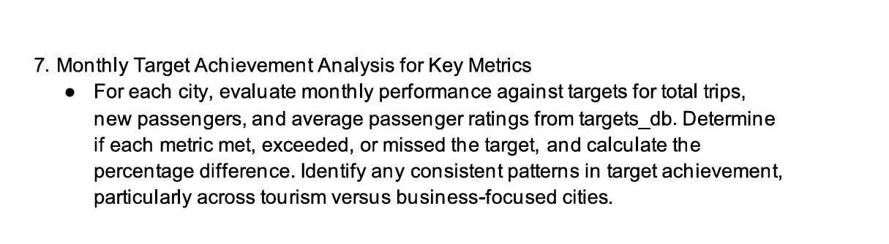

Slide 26
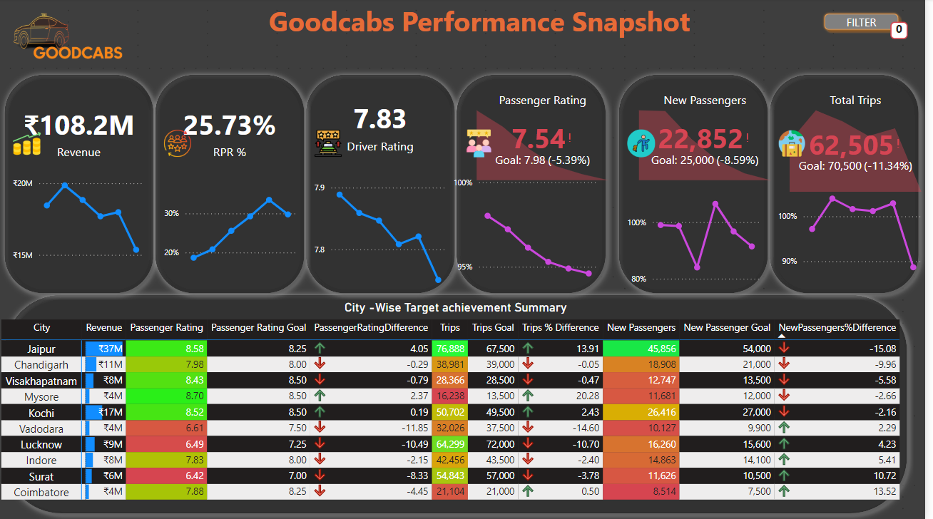

Slide 27
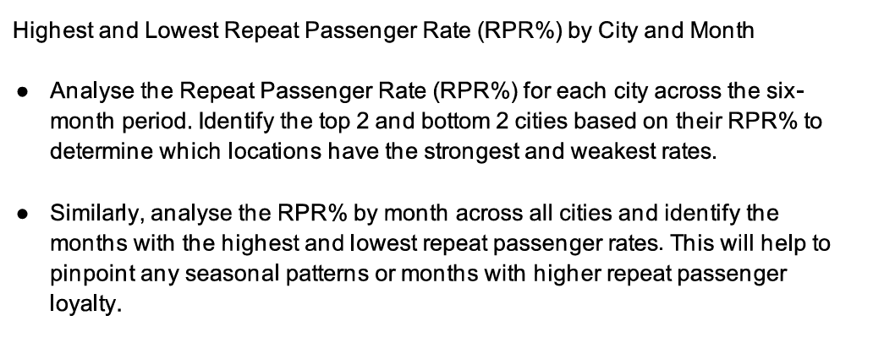

Slide 28
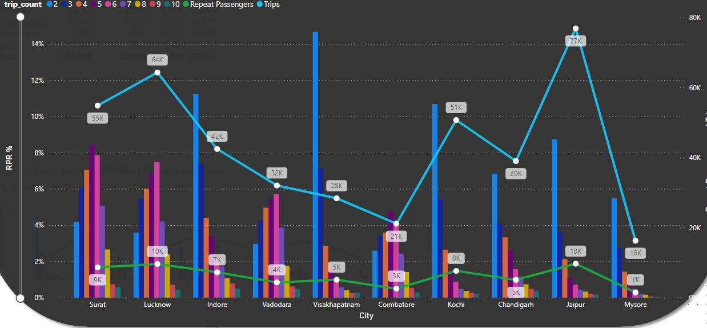
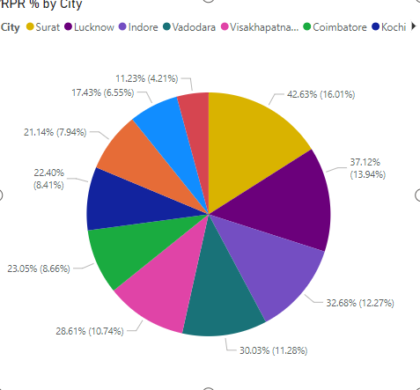

Slide 29
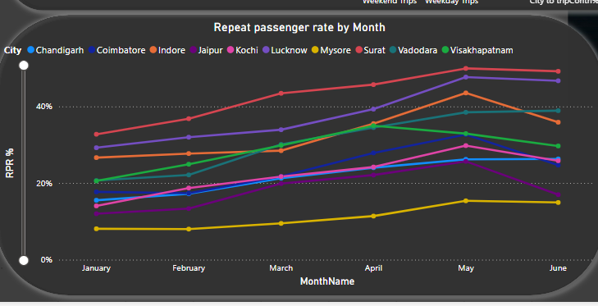
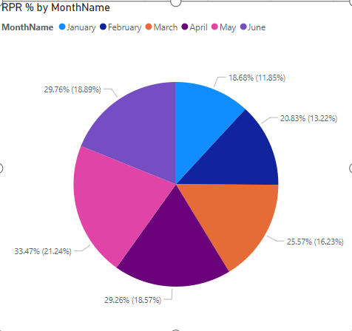
Notes:
Insights from Data
Repeat Passenger Frequency and City Contribution Analysis
(a) Repeat Passenger Behavior:
Most Common Trip Frequencies by City:
Jaipur, Kochi, and Visakhapatnam show the highest percentage of 2-trip repeat passengers, indicating these cities might attract one-time return visitors.
Surat and Lucknow see a higher frequency of 5-6 trips among repeat passengers, suggesting consistent repeat behavior.
Cities with Higher Repeat Trip Frequencies:
Business-focused cities like Lucknow and Surat exhibit steady repeat trip patterns, likely due to regular commuter traffic.
Tourism-centric cities such as Jaipur and Mysore show peaks during seasonal demands but lack consistency throughout the year.
(b) City Contribution:
Cities Contributing Most to Repeat Passenger Trips:
Jaipur, Lucknow, and Surat consistently contribute a significant percentage to overall repeat passenger trips.
Surat shows high contribution percentages, despite moderate total trips, suggesting strong customer loyalty.
Comparison Across City Types:
Tourism-focused cities like Jaipur show higher trip frequencies during specific periods (e.g., festivals or vacation seasons).
Business-focused cities like Lucknow demonstrate steadier repeat passenger contributions, reflecting regular commuter needs.
(c) Patterns by City Type:
Tourism-Focused Cities:
Jaipur has a higher proportion of 2-trip passengers, likely due to seasonal tourists returning for festivals or events.
Mysore shows a similar pattern with peaks during cultural and holiday seasons.
Business-Focused Cities:
Lucknow and Surat demonstrate steady repeat passenger frequencies, driven by commuter and business traffic.
Highest and Lowest Repeat Passenger Rate (RPR%) by City and Month
(a) City-Level Analysis:
Top Cities by RPR%:
Visakhapatnam (51.25%) and Jaipur (50.14%) have the highest RPR%, driven by strong seasonal demand and loyal repeat passengers.
Mysore, though a smaller contributor, shows a high RPR% (48.75%), indicating strong local engagement.
Bottom Cities by RPR%:
Jaipur (in low-demand months) and cities like Coimbatore (1.22%-2.31%) consistently exhibit the lowest RPR%, signaling potential issues with service quality or competition.
(b) Monthly Analysis:
Highest Repeat Passenger Rates:
Peak months align with seasonal demand in tourism cities (e.g., Jaipur in festive seasons).
Business cities like Lucknow show steady rates with slight peaks in months coinciding with major local events or trade seasons.
Lowest Repeat Passenger Rates:
Low seasons (e.g., off-peak travel months) significantly impact cities like Mysore and Coimbatore, resulting in lower RPR%.

Slide 30
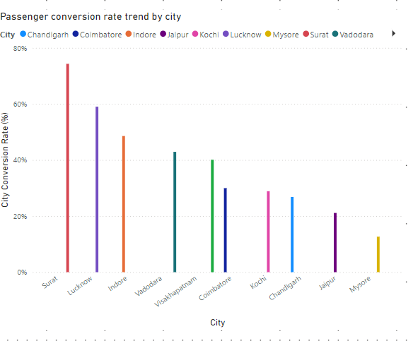
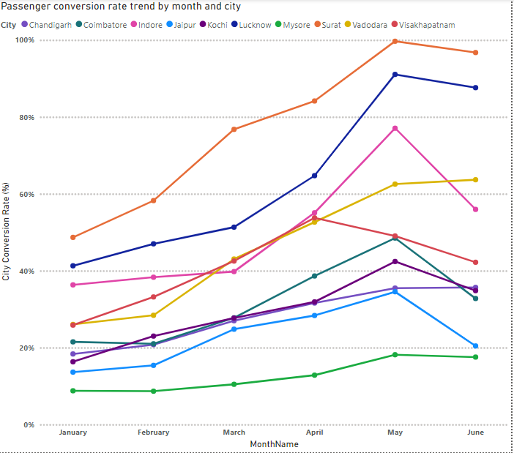

Slide 31
Key Insights
Cities with Consistent Repeat Passengers:
Lucknow and Surat emerge as consistent performers, with steady contributions to trip counts and repeat frequencies. These cities likely benefit from reliable service, competitive pricing, and stable demand.
Seasonal Patterns and Loyalty:
Tourism-focused cities like Jaipur and Mysore experience seasonal spikes but lack year-round loyalty. Tailored marketing campaigns and promotional offers during low seasons can improve retention.
Improvement Strategies for Low-Performing Cities:
Cities like Coimbatore and Vadodara need targeted strategies such as:
Enhanced service quality: Better customer feedback mechanisms and improved ride availability.
Pricing campaigns: Introduce loyalty discounts or offers to incentivize repeat bookings.
Local partnerships: Collaborate with local businesses and events to drive traffic.
Targeting Low-Performing Months:
Address off-season challenges through dynamic pricing, event-based promotions, and better visibility of services during these periods.

Slide 32
Cohort Analysis
Q7: How do passenger cohorts behave over time?
Insight:
New passenger retention is highest in Kochi, with 67.6% of new passengers taking another trip within the first month.
Jaipur has steady repeat customer growth, indicating strong word-of-mouth or customer satisfaction.
Funnel Analysis
Q8: What is the conversion rate from new to repeat passengers?
Insight:
Kochi: 28.5% of new passengers convert to repeat passengers.
Lucknow: 22.3% conversion, suggesting room for improvement.
Predictive Analysis
Q9: Which cities are likely to see demand growth based on past trends?
Insight:
Cities like Jaipur and Kochi, with consistent high ratings and repeat passenger contributions, are expected to maintain demand growth.
Surat and Vadodara may face stagnation unless pricing strategies and service quality improve.
RFM Analysis
Q10: Which cities have the most valuable customers (frequent, recent, and high spenders)?
Insight:
Most Valuable Cities: Jaipur and Kochi, due to high trip frequency and high average revenue per trip.
Least Valuable: Surat and Vadodara, with lower trip frequency and spend per trip.

Slide 33
Factors Driving Repeat Passenger Rates
Service Quality:
High RPR% Cities: Surat, Lucknow, Indore
Timely service, high driver ratings.
Low RPR% Cities: Mysore, Vadodara, Coimbatore
Variability in service experience.
Pricing:
Competitive pricing in business cities drives repeat usage.
Fluctuations in tourism cities affect retention.
Demographics:
Business hubs: Higher income leads to affordability and loyalty.
Tourism cities: Diverse profiles lower repeat rates.
Key Insight: Reliability and consistent pricing are key for higher RPR%.

Slide 34
Tourism vs. Business Demand
Seasonal Trends Driven by Events and Tourism
Tourism-Focused Cities:
Jaipur and Kochi see peaks in March (spring festivals, cultural events).
Demand drops in May-June due to summer heat or offseason for tourism.
Example: Jaipur’s trip volume increases by 25% during the festival season (March-April).
Business-Focused Cities:
Surat and Indore exhibit consistent demand throughout the year, with slight dips during holidays.
Business meetings and conferences ensure steady passenger flow.
Key Insight: Tourism cities experience demand spikes during seasonal events, while business cities have consistent travel patterns.

Slide 35
Monthly Target Achievement
Performance Versus Targets
Top Performing Cities:
Surat and Lucknow exceeded targets for total trips and passenger ratings in 5 out of 6 months, with an average 8-12% surplus.
Jaipur met new passenger targets during peak months (March-April), exceeding by 15%.
Underperforming Cities:
Mysore missed total trip and rating targets by 10-15% monthly, primarily due to inconsistent demand and lower repeat rates.
Coimbatore underperformed in new passenger acquisition by 20%, indicating weak marketing efforts.
Key Insight: Business cities outperform tourism cities in meeting trip and rating targets due to predictable, recurring demand.

Slide 36
Repeat Passenger Rate (RPR%)
City and Monthly Level Analysis
City-Level Performance:
High RPR% Cities:
Surat (32%), Lucknow (28%), and Indore (30%).
Consistent with high-quality services and repeat travel incentives.
Low RPR% Cities:
Mysore (11%), Coimbatore (15%), and Vadodara (16%).
Driven by transient or one-time travelers and limited incentives.
Monthly Trends:
Highest RPR% Months: January and March:
Reflect holiday travel and post-year-end business renewals.
Lowest RPR% Months: June:
Seasonal travel dips in tourism cities; summer vacations reduce demand in business hubs.
Key Insight: High RPR% correlates with service consistency and targeted loyalty programs, while seasonality affects tourism-focused cities.

Slide 37
New Passengers Growth
Cities with the Highest and Lowest Growth
Highest Growth:
Jaipur (+25%) and Kochi (+20%) during March-April due to tourism spikes.
Lucknow (+18%) driven by aggressive marketing and expanding business zones.
Lowest Growth:
Mysore (-12%) and Vadodara (-8%) due to ineffective customer engagement and low awareness campaigns.
Coimbatore (-10%) faces tough competition from regional transport options.
Key Insight: Growth in new passengers is heavily influenced by city type (tourism or business), seasonal campaigns, and effective marketing.

Slide 38
Business Impact
Revenue Growth:
Business hubs like Surat and Lucknow project a 10-15% increase in annual revenue due to high repeat travel rates.
Tourism cities like Jaipur and Kochi contribute significant seasonal revenue, accounting for 30% of total revenue during peak months.
Operational Efficiency:
Consistent resource allocation in business cities ensures demand-supply balance.
Seasonal adjustments in tourism cities optimize vehicle utilization and reduce idle time.

Slide 39
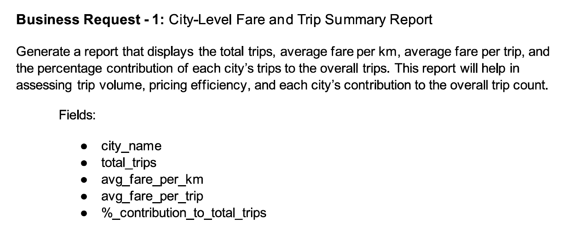

Slide 40
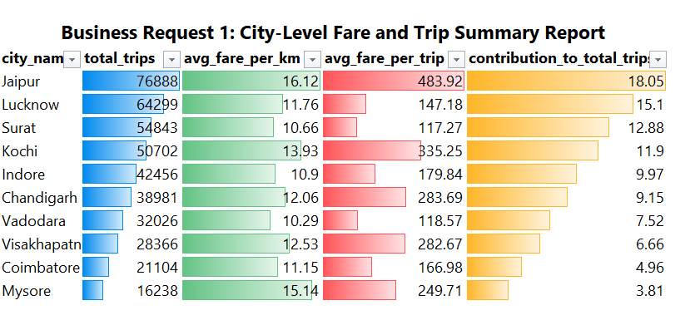

Slide 41
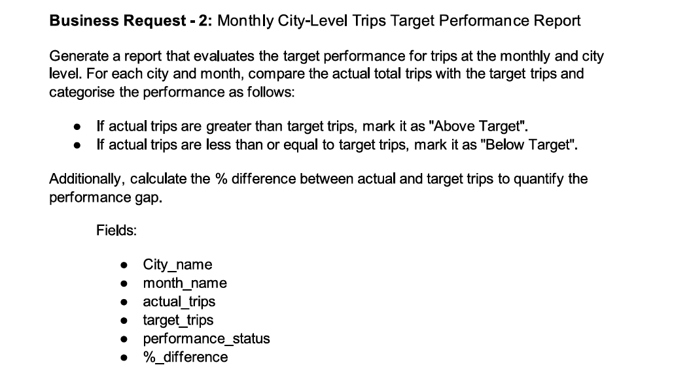

Slide 42
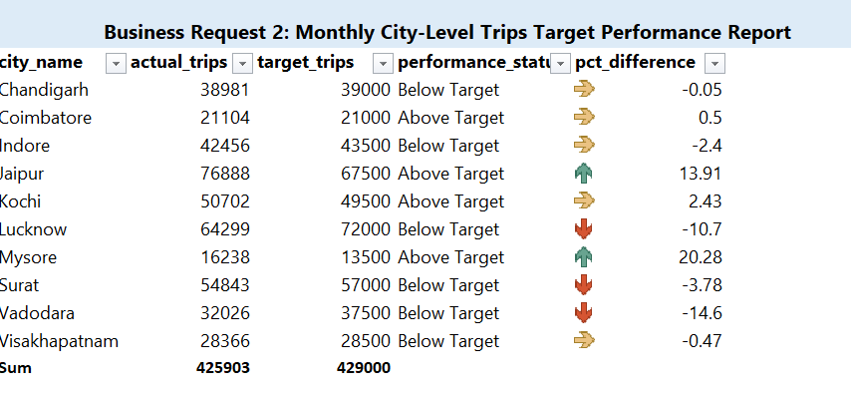

Slide 43
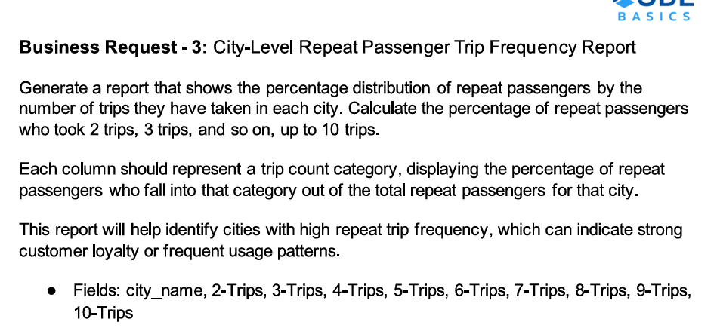

Slide 44
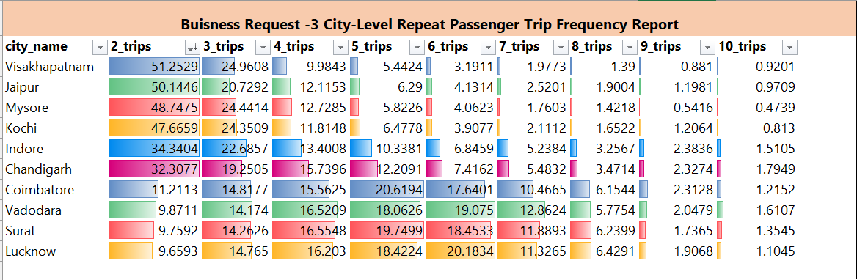

Slide 45
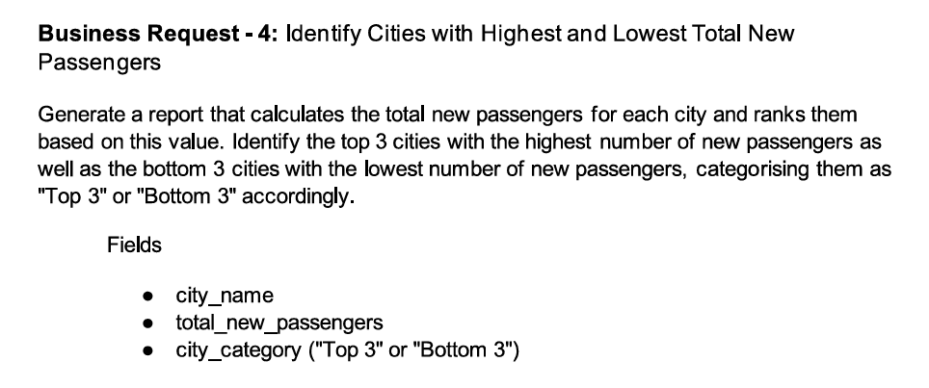

Slide 46
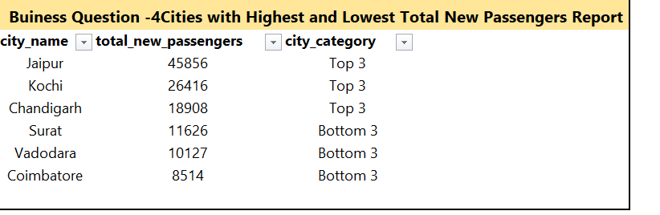

Slide 47
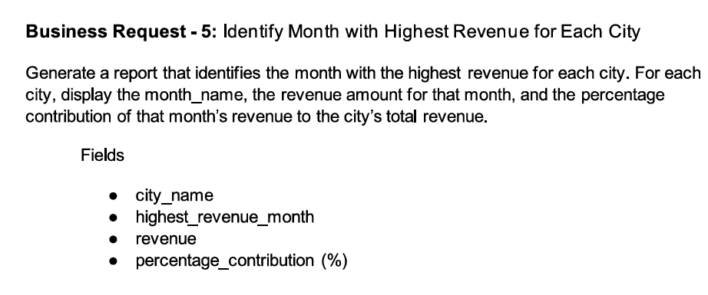

Slide 48
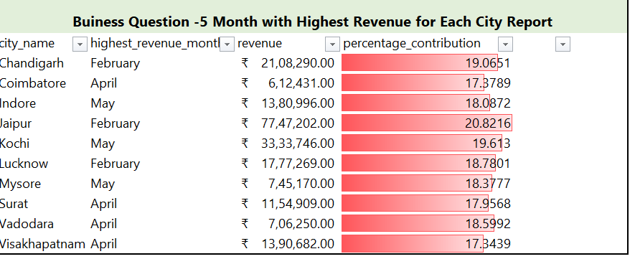

Slide 49
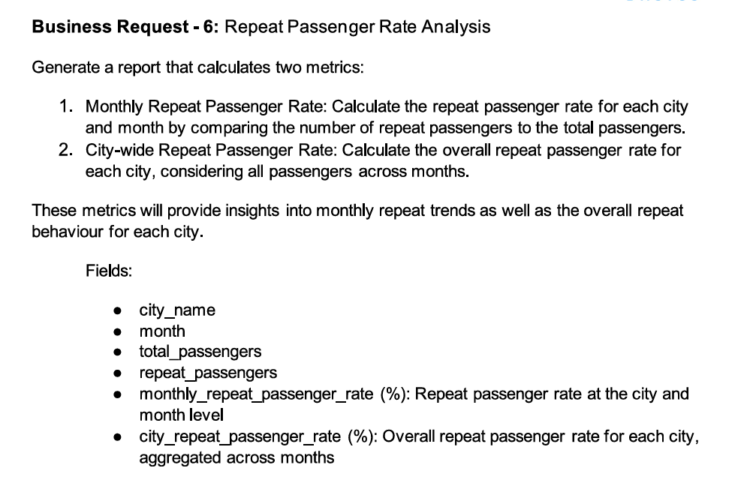

Slide 50
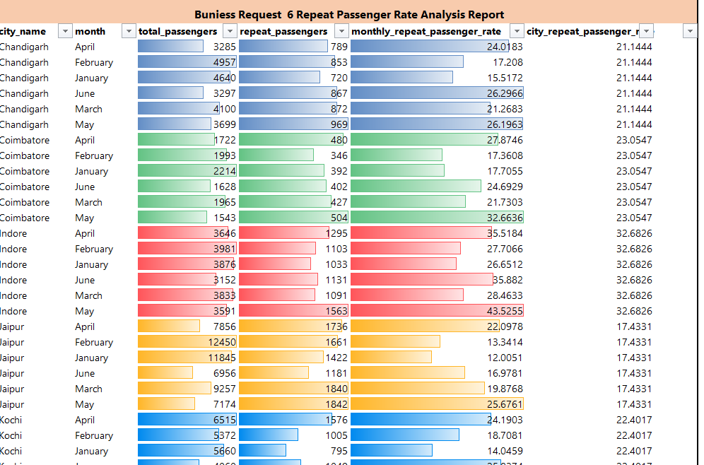

Slide 51
Analysis and Insights
Primary Analysis:
- Top 3 Cities: Highest Revenue and RPR%.
- Seasonal Trends: Demand peaks in May and December.
- Weekend vs. Weekday Trends: 40% higher weekend demand.
Secondary Analysis:
- Factors influencing RPR%: Service quality, pricing, and city demographics.
- Tourism vs. Business Impact: Higher demand during festivals in tourism-heavy cities.

Slide 52
Recommendations
Service Enhancements for Repeat Passengers:
Reward programs for high RPR% cities (e.g., Jaipur and Kochi).
Training for service quality improvement in cities with low ratings.(Surat and Vadodara.
Targeted Campaigns:
Tourism-focused incentives in Jaipur during peak months.
Promotions for business cities like Chandigarh to retain corporate clients.
Resource Allocation:
Increase resources during high-demand months in tourist cities.
Introduce cost-saving ride options during offseason periods in cities like Mysore.
Data-Driven Pricing Models:
Address fare inefficiencies in cities like Vadodara by aligning trip distance and pricing.
Implement dynamic pricing in Jaipur and Kochi during peak periods.

Slide 53
. BUSINESS IMPACT (PROJECTED)
Revenue Growth: Optimizing pricing could improve revenue per trip by 10–15% in low-performing cities.
Retention Strategies: Boosting repeat passenger loyalty by 20% may increase overall revenue by ₹50+ L per month.
Operational Savings: Improved fleet utilization in Coimbatore and Surat can reduce costs by 8–12%.

Slide 54
FUTURE STRATEGIES
Partner with local businesses for cross-promotions with Exclusive partnerships with hotels , malls, Corporate offices with eye- catching discounts
- Explore emerging trends like EV adoption with pilot program in selected cities
-Introduction of Eco –friendly initiatives like electric- car sharing program and eco- friendly materials.
Data collection upon customer behaviour like ride frequency, peak hours, popular routes, and customer feedback.
• Operational Efficiency Data: Track driver performance, vehicle utilization rates, and maintenance schedule.
• Market Trends Data: Monitor competitor performance, customer preferences, and regional demand shifts to stay ahead of the market curve.

Slide 55


